Slide 1

PREPARE AND DISPLAY SUGAR WORK
D1.HPA.CL4.03
Notes:
Welcome the Students to the class

Slide 2

Prepare and display sugar work
Assessment for this Unit may include:
Oral questions
Written questions
Work projects
Workplace observation of practical skills
Practical exercises
Formal report from employer/supervisor
Notes:
Trainer to Advise:
Trainer advises students that assessment for this Unit may take several forms all of which are aimed at verifying they have achieved competency for the Unit as required.
Trainer indicates to students the methods of assessment that will be applied to them for this Unit.

Slide 3

Prepare and display sugar work
References and further reading for this unit:
There are many visual stimuli on YouTube
Search: pulled sugar, blown sugar
Excellent book reference
The art of the confectioner:
Pastillage and Sugar work
Ewald Notter
Basic preparations and advanced work
Notes:
Trainer to Advise:
There are many books and guides in the market place
Difficult to learn this without hands on experience and also an artistic flair is very beneficial
Visual stimuli is available on YouTube.

Slide 4

Prepare and display sugar work
This unit comprises eight elements:
Prepare sugar for boiling
Boil sugar
Pull boiled sugar
Use pulled sugar to produce display work
Pour boiled sugar to produce cast display sugar work
Plan sugar display piece
Assemble and display sugar work
Store sugar display pieces
Notes:
Trainer to advise:
Trainer advises students this Unit comprises eight elements, as listed on the slide explaining:
Each Element comprises a number of Performance Criteria which will be identified throughout the class and explained in detail
Students can obtain more detail from their Trainee Manual
The course presents advice and information but where their workplace requirements differ to what is presented, the workplace practices and standards must be observed.

Slide 5
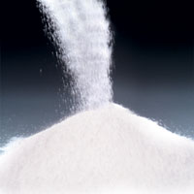
Prepare and display sugar work
Element 1: Prepare sugar for boiling
Select and weigh ingredients
Combine ingredients and prepare sugar for boiling
Collect equipment required to prepare sugar
Notes:
Trainer to advise:
Trainer to relate performance criteria to element 1
Performance criteria is the process by which the students training match the learning element
The element is the skill
To assess competency in the skill; the performance criteria is used to outline activities that can be used to assess competency.
The trainer should relate how the performance criteria is related to the element
To be able to Prepare and display sugar work the students must be able to; Pull boiled sugar
The student should be able to do
Collect equipment required to pull boiled sugar
Manipulate boiled sugar
Store/hold pulled sugar

Slide 6
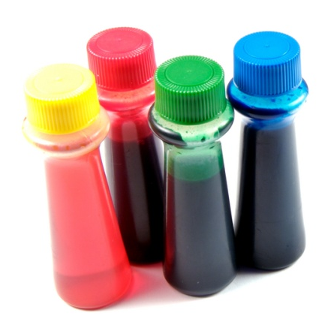
Prepare sugar for boiling
Select and weigh ingredients:
Sugar
Glucose
Water
Titanium oxide, if required
Colour, if required
Notes:
Trainer to advise:
Select and Weigh all ingredients before beginning the process
Ensure that enough of each ingredient is available
Normal table sugar is best for this activity
Students need to find an explanation or definition of how sugar can be purchased in their market place
The term market place is not where you purchase general food items for the home
The market place is the Bakery Patisserie in which they are conducting business
A1 or1A sugar general table sugar
Caster sugar best for use in pastry
Pure Icing sugar very fine grind, can be referred to confectioners sugar
Soft icing mixture Icing sugar with starch added to stop clumping due to hydroscopic properties of sugar
Brown sugar sugar with residual molasses added
These are types of sugar available in the Australian market for the patissier

Slide 7
Prepare sugar for boiling
Collect equipment required to prepare sugar:
Pot: Good quality, preferable copper or stainless steel
Heat source: Kitchen stove, portable gas burner
Stirrer: Steel spoon, clean wooden, heat resistant silicon
Work surface: Marble or Granite
Silicon mat: Several if possible
Small Equipment: Heavy duty scissors; knife; spoons
Scales: Digital scales, portable
Notes:
Trainer to advise:
Equipment required for the preparation of sugar will depend on the type being produced
A well set up kitchen will be ideal but people become inventive when lacking the best equipment
Sugar can be boiled and moulded in any area when person becomes familiar with the skills required

Slide 8
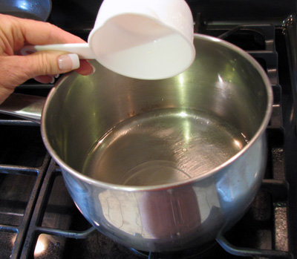
Prepare sugar for boiling
Combine ingredients and prepare sugar for boiling:
Water in pot
Sugar in water
Mix together
Dissolve sugar before water boils
Notes:
Trainer to advise:
Place the water into a clean pot
Add sugar to the water
This moistens all the sugar and helps it to dissolve.
Sugar can re-crystalise when in solution merely due to the fact that a grain of sugar has fallen into the solution.
This can happen when sugar is 160 degrees plus. It merely goes hard again and the process needs to start all over again
Keep side of pots clean with pastry brush and cold water
Do not stir after sugar solution has started to boil because the agitation can also cause the sugar to re-crystalise.

Slide 9
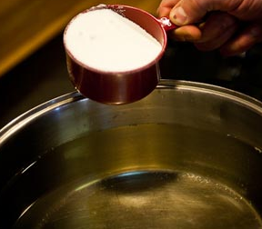
Prepare and display sugar work
Element 2: Boil sugar
Collect equipment required to boil sugar
Follow specified method of sugar boiling
Use colours appropriately
Handle boiled sugar solution safely
Notes:
Trainer to advise:
Trainer to relate performance criteria to element 2
Performance criteria is the process by which the students training match the learning element
The element is the skill
To assess competency in the skill; the performance criteria is used to outline activities that can be used to assess competency.
The trainer should relate how the performance criteria is related to the element
To be able to Prepare and display sugar work the students must be able to; Boil sugar
The student should be able to do;
Collect equipment required to boil sugar
Follow specified method of sugar boiling
Use colours appropriately
Handle boiled sugar solution safely

Slide 10
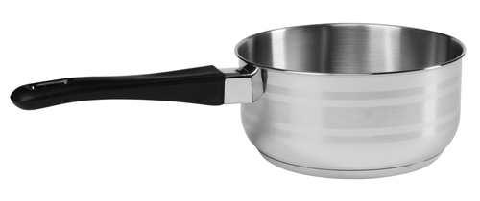
Boil Sugar
Collect equipment required to boil sugar
Pot: Good quality, preferable copper or stainless steel
Heat source: Kitchen stove, portable gas burner
Stirrer: Steel spoon, clean wooden, heat resistant silicon
Work surface: Marble or Granite
Silicon mat: Several if possible
Small Equipment: Heavy duty scissors; knife; spoons
Pastry brush: Stainless steel bowl with water
Notes:
Trainer to advise:
Equipment required for the preparation of sugar will depend on the type being produced
A well set up kitchen will be ideal but people become inventive when lacking the best equipment
Sugar can be boiled and moulded in any area when person becomes familiar with the skills required
For the boiling process to begin all equipment required for the process of moulding should be prepared
Before you begin to cook the sugar the mould must be prepared ready to accept the sugar
When the sugar reaching correct temperature it must be poured immediately
Either into the prepared cast or mould or onto a prepared surface for pulling to produce satin finish

Slide 11
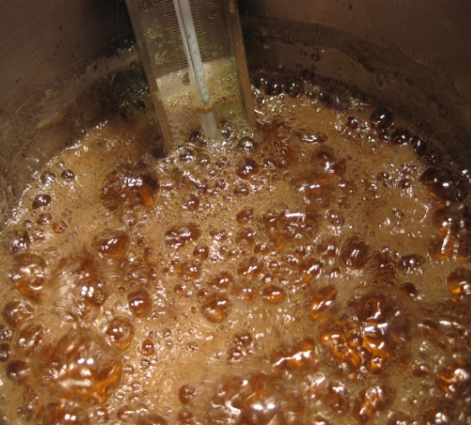
Boil Sugar
Follow specified method for boiling sugar
Water and sugar in pot
Glucose, if required, set aside
Apply heat source, stir to dissolve
Bring to boil
Skim any scum that rises
Add glucose, stir to mix in
Stir no more
Cook to required temperature
Notes:
Trainer to advise:
Basic procedure for boiling all sugar solutions
Place on the heat source and stir slowly to dissolve the sugar
Wash sides of pot down with cold water and pastry brush
This is to prevent the sugar solution that sticks to the sides of the pot from dehydrating and forming sugar crystals. If the sugar crystals fall back into the solution there is the possibility that it will act as a seeding agent and this will cause all the sugar to re-crystalise
The glucose can be warmed before going into solution; in microwave or just warmed in another pot; this is recommended in colder environments as when it is added to boiling solution it does not slow down the boiling process to a great extent.
When the solution has come to the boil add the glucose
Stir to distribute the glucose through the solution then remove stirrer
Do not stir the solution again; agitation of the solution can cause crystallization
Cook the solution to the required temperature
Add tartaric acid if required at 145 degrees
If colour is to be added then add at approximately 150 degrees
Continue to cook to 160 degrees

Slide 12
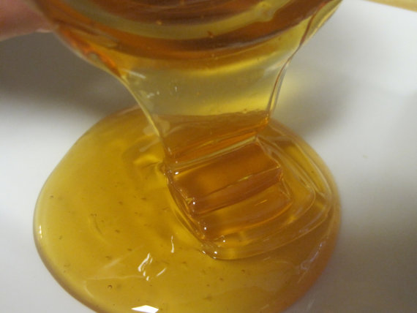
Boil Sugar
Use colours appropriately
Add colours just before reaching required temperature
Paste colours
Water based colours better
Alcohol based colours can distort colours after boiling
Notes:
Trainer to advise:
Adding colours to sugar takes practice. It is not the adding of the colour but how the colour looks after it has been added
The brand
Quality of colour
Concentration of the colour
Brightness
HOW MUCH of the colour do you need to add
It all takes practice; keep note as with all recipes and methods; keep notes on the reactions when using a new product for the first time
Water based colours are best added in the last few minutes of the boiling so excess moisture can be evaporated off

Slide 13
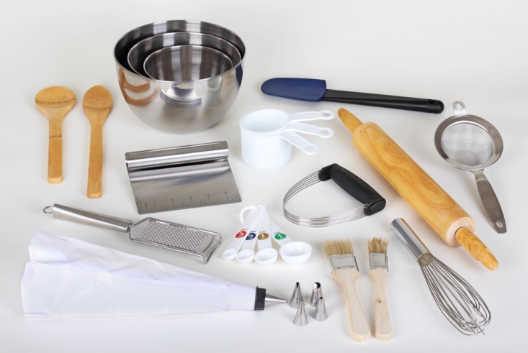
Boil Sugar
Handle boiled sugar solution safely
Heat resistant material
Thick folded tea towels
Wooden blocks
Cold water reserve
Notes:
Trainer to advise:
Sugar is boiled to temperatures in in excess of 160 degrees
At this temperature the human skin will just be destroyed within 1 second of contact
RESPECT the sugar;
respect the temperature
THINK
There will be no second chance
Heat resistant material
Thick folded tea towels
Thick gloves can be difficult to use and thick cotton gloves are not recommended because if the gloves are wet or even damp and the gloves come into contact with hot metal for any period of time they will heat up and produce STEAM; if the gloves cannot be removed quickly then they become a danger in themselves
Steam burn are just as bad as dry burns on the human skin
Folded tea towels between the hot metal and the human skin allows for a faster release of the pot handle
Care must be taken to still control the molten sugar and not to drop the pot of sugar and cause more damage. Put the pot of molten sugar onto a stable flat surface before releasing grip of hot pot
Wooden blocks
Wooden blocks are a good medium to use to reduce heating the workbench surface
Cold water reserve
Always have a bowl of cold water nearby to cool any sugar that comes into contact with human skin. It is easy to remove from skin when it has set.
If you try to remove while it is still molten you will just increase the damage

Slide 14
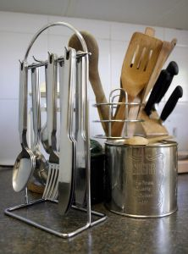
Prepare and display sugar work
Element 3: Pull boiled sugar
Collect equipment required to pull boiled sugar
Manipulate boiled sugar
Store/hold pulled sugar
Notes:
Trainer to advise:
Trainer to relate performance criteria to element 3
Performance criteria is the process by which the students training match the learning element
The element is the skill
To assess competency in the skill; the performance criteria is used to outline activities that can be used to assess competency.
The trainer should relate how the performance criteria is related to the element
To be able to Prepare and display sugar work the students must be able to; Pull boiled sugar
The student should be able to do
Collect equipment required to pull boiled sugar
Manipulate boiled sugar
Store/hold pulled sugar

Slide 15
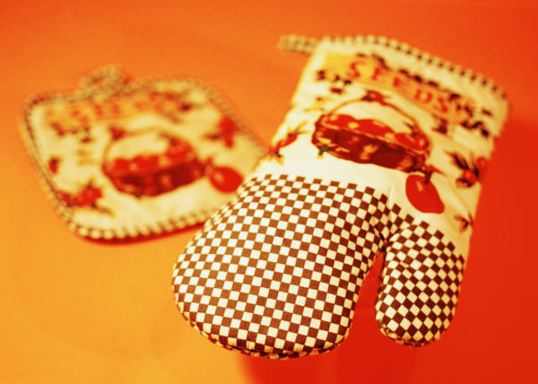
Pull boiled sugar
Collect required equipment
Silicon mat or sheet
Marble or granite stone workbench or slab
Oil, food grade, non flavoured
Gloves
Scissors
Spatulas
Notes:
Trainer to advise:
Silicon mat or sheet
The boiled sugar will be poured onto this or an oiled marble bench or oiled slab of granite stone
Marble or granite stone workbench or slab
Oiled to prevent sugar sticking and will aid in the cooling
Oil, food grade, non flavoured
Needs to be applied very sparsely, you do not want the oil entering inside the sugar when folding and pulling
Gloves
Always wear latex gloves when pulling. Sometime it is advisable to have thin cotton gloves under latex gloves to insulate
Scissors
Are used to cut pulled sugar into portions when ready so it can be stored until required. Easier to reheat
Spatulas
Small triangle blade plaster spreaders or cooks spatulas are ideal for turning the sugar back onto itself while it is cooling until it can be handled by hand
Used to lift the edge and drop back into the centre of the hot solution as it cools

Slide 16
Pull boiled sugar
Manipulate pulled sugar
Pull apart
Fold back together
Twist and pull
Fold back
Continue action until desired look is achieved.
Notes:
Trainer to advise:
When the sugar has cooled sufficiently to be picked up and handled it can be gripped with two hands and pulled slightly and then fold back together.
This process will happen up to 35 times
When folding it can be twisted and folded back together
Why?
This action introduces air into the sugar mass and it takes on a satin or opaque sheen
This action is continued until the desired look is achieved

Slide 17

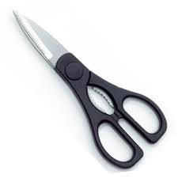
Pull boiled sugar
Store or hold pulled sugar
Portion buy cutting with heavy duty scissors
Allow to cool completely
Wrap in plastic until required
Notes:
Trainer to advise:
The sugar needs to be portioned while it is still pliable
When portioned it should be left to cool completely
Seal in plastic. Remove all air and store in sealable container
In warmer climates silica gel sachets need to be placed into storage containers
Moisture is the enemy of sugar

Slide 18
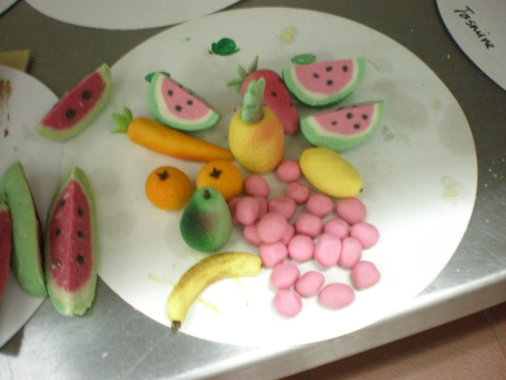
Prepare and display sugar work
Element 4: Use pulled sugar to produce display work
Collect equipment required to produce display sugar pieces
Produce blown sugar shapes
Produce ribbons and bows
Shape sugar pieces into leaves and flowers
Weave sugar to form baskets
Notes:
Trainer to advise:
Trainer to relate performance criteria to element 4
Performance criteria is the process by which the students training match the learning element
The element is the skill
To assess competency in the skill; the performance criteria is used to outline activities that can be used to assess competency.
The trainer should relate how the performance criteria is related to the element
To be able to Prepare and display sugar work the students must be able to; Use pulled sugar to produce display work
The student should be able to
Collect equipment required to produce display sugar pieces
Produce blown sugar shapes
Produce ribbons and bows
Shape sugar pieces into leaves and flowers
Weave sugar to form baskets

Slide 19
Use pulled sugar
Collect equipment required
Plan: What are you making
Heat source: heat lamp to reheat sugar
Work surface: Marble or Granite
Silicon mat: several if possible
Blower: Copper or heat resistant pipe attached to hand pump
Small Equipment: Heavy duty scissors, knife, heat gel, cooling fan, small plastic containers, plastic wrap
Notes:
Trainer to advise:
Plan: What are you making
Heat source; heat lamp to reheat sugar
The sugar portion will be placed onto a silicon mat under the heat lamp
The heat lamp slowly warms the sugar
Sugar needs to be regularly turned so the sugar can heat evenly
Blower: Copper or heat resistant reed attached to hand pump
Sugar is attached to end and air is introduce to inside of piece of sugar and while sugar is pliable different shapes are formed
Then cooled to hold shape produced
Work surface; Marble or Granite
Good surface to work with
Silicon mat; several if possible
Small Equipment: Heavy duty scissors; knife;
As the sugar is formed pieces may need to be trimmed
Small plastic containers;
Can be handy to hold small pieces after they have been formed
Line with plastic wrap scrunched up loosely to give support to still warm pieces without deforming them on flat surface
heat gel
Burns a single flame that can be used to melt sections without warming the whole model; for binding sugar pieces together
Plastic wrap
To line containers to stop pieces banging into each other
Cooling fan; Hair dryer
Some have a hot and cold fan; for fast temperature changes to sugar

Slide 20

Use pulled sugar
Produce blow sugar
Consult plan
Attach portion of softened sugar to blower pipe
Introduce air to inside of sugar slowly and in short bursts
Manipulate into desired shape
Re warm under heat source if needed
Remove from blower
Cool to hold shape
Watch this you tube video:
http://www.youtube.com/watch?v=vxciGVtOmFg
Notes:
Trainer to advise:
YouTube Chef Robert Lombardy: Inland Northwest Culinary; Spokane; Washington State; USA
http://www.youtube.com/watch?v=vxciGVtOmFg
Consult plan
What are you going to produce/ Do you have a drawing to compare your model with?
Attach portion of softened sugar to blower pipe
Take a portion of softened sugar and totally enclose the end of a pipe. When totally sealed:
Introduce air to inside of sugar slowly and in short bursts
Manipulate into desired shape
Re warm under heat source if needed
Remove from pipe by cutting while retaining shape
Cool to hold shape

Slide 21
Use pulled sugar
Produce ribbons and bows
Multiple colours
2 colours: red and green
Roll into sticks
Refer to youtube video ‘sugar ribbon’
Stretch to size required
Cut and mould as shown in video
Notes:
Trainer to advise:
Start with just two colours
Warm pieces of sugar size of finger
Attach to each other
Manipulate long, stretch, trying to keep same thickness
Stretch to final thickness
Cut to length
Warm and shape
Cool to shape

Slide 22
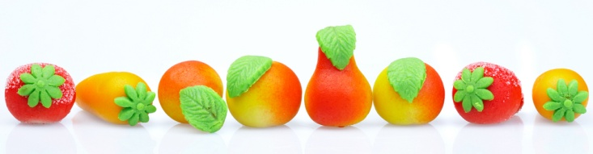
Use pulled sugar
Shape sugar pieces into leaves and ribbons
Weaving a sugar basket and fruits
Youtube: The art of sugar craft, filmed and edited by Leon Arndt, ICT Services:
http://www.youtube.com/watch?v=7vK7lTghbe0&feature=g-vrec
Refer to manual
Notes:
Trainer to advise:
Refer to manual or obtain a video from you tube source for visual display
Weaving a sugar basket and fruits
You tube
The art of sugar craft; filmed and edited by Leon Arndt, ICT Services
http://www.youtube.com/watch?v=7vK7lTghbe0&feature=g-vrec

Slide 23
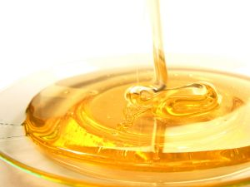
Prepare and display sugar work
Element 5: Pour boiled sugar to produce cast display sugar work
Collect equipment required to produce cast display sugar work pieces
Add specific ingredients to create effects
Pour and set sugar
Release sugar from forms
Notes:
Trainer to advise:
Trainer to relate performance criteria to element 5
Performance criteria is the process by which the students training match the learning element
The element is the skill
To assess competency in the skill; the performance criteria is used to outline activities that can be used to assess competency.
The trainer should relate how the performance criteria is related to the element
To be able to Prepare and display sugar work the students must be able to; pour boiled sugar to produce cast display sugar work
The student should be able to
Collect equipment required to produce cast display sugar work pieces
Add specific ingredients to create effects
Pour and set sugar
Release sugar from forms

Slide 24
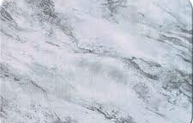
Pour boiled sugar to produce cast model
Collect equipment required to produce cast sugar
Plan: What are you making
Stove: stove or portable gas burner
Moulds: plain or textured
Work surface: Marble or Granite
Silicon mat: several if possible
Small Equipment: Heavy duty scissors, knife
Silicon paper
Notes:
Trainer to advise:
Working from a plan the model must be broken down into sections
Cast models have several sections that may sit at different level
Cast models may lay flat
May stand up; several pieces set at different places on the base give appearance of Depth
Moulds of the shapes that are going to be moulded
Stove and pot
Small equipment: should always be on hand

Slide 25
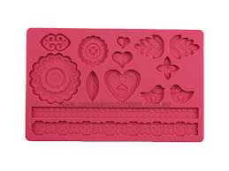
Prepare and display sugar work
Add specific ingredients to create effects:
Titanium dioxide:
Turns sugar solutions white
Elements to be suspended inside:
Gold, green fleck
Crinkled foil:
Uneven base shows through clear sugar
Preformed mould cast
Notes:
Trainer to advise:
Titanium dioxide
Is a natural substance that can be used to give boiled sugar a white colour; helps with showing opaque colours
Elements to be suspended inside
Silver sparkle or small filings can be added for sparkle in clear
Crinkled foil
Crinkling the foil will show imperfection in foil surface and this will show through a clear sugar cast
Preformed mould cast
Silicon moulds can be preformed to shapes of leaves and these do not have to be added as when hand moulding
See Chicago School of mould making website

Slide 26
Prepare and display sugar work
Pour and set sugar
Prepare mould, trim edges
Oil inside to reduce sticking
One pour
Continuous motion
Bottom to top, side to side
Notes:
Trainer to advise:
Before pouring ensure that the mould is ready
It is sitting correctly
Edges are sealed
Mould edges are not going to move when sugar is poured
When pouring into cast pour slowly for an even flow
Move from one end or side of mould to the other
This will take practice
If you pour and move too quickly on large moulds and then come back to ‘Top up’ the amount of sugar it may show a wave in the sugar
If waves in cast do not matter then all will be ok
Allow sugar to set;
If pieces are small they may be able to be slid into base of baking tray and set aside to cool if tray base is flat and will not distort model

Slide 27
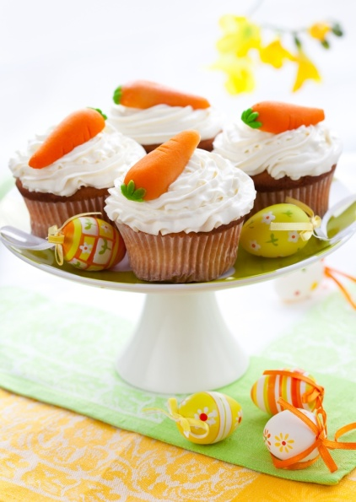
Prepare and display sugar work
Release sugar from forms
Care needs to be taken
When will sugar hold shapes and not distort when released from mould
Metal moulds are hardest
Tap to loosen
Poured on to oiled marble
Sugar needs to be ‘lifted to prevent sticking
Notes:
Trainer to advise:
You have boiled the sugar and poured into mould
All can be for nothing because it has failed to come out of the mould
Firm moulds like steel cake rings can be a problem of the sugar sets and it may crack if it is too cold.
You cannot have the sugar ‘flex’ or bend when cold. It does not do this, it cracks.
So remove from mould as soon as possible; it just needs to hold shape.
Sometimes a light tap will release.
Warm the edges of the mould with blow torch
If poured directly onto oiled marble bench it will need to be lifted slightly to allow air under to prevent the sugar sticking when cooling

Slide 28
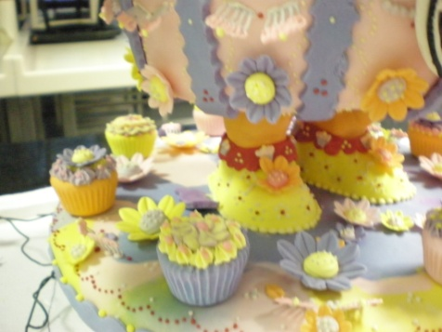
Prepare and display sugar work
Element 6: Plan sugar display piece
Plan display piece appropriate to client, occasion or theme able to be produced in time available using a variety of techniques
Prepare a sketch or outline of display
Prepare forms and shapes as required by the design
Calculate quantities required for components of display piece
Notes:
Trainer to advise:
Trainer to relate performance criteria to element 6
Performance criteria is the process by which the students training match the learning element
The element is the skill
To assess competency in the skill; the performance criteria is used to outline activities that can be used to assess competency.
The trainer should relate how the performance criteria is related to the element
To be able to Prepare and display sugar work the students must be able to; Plan sugar display piece
The student should be able to
Plan display piece appropriate to client, occasion or theme able to be produced in time available using a variety of techniques
Prepare a sketch or outline of display
Prepare forms and shapes as required by the design
Calculate quantities required for components of display piece

Slide 29
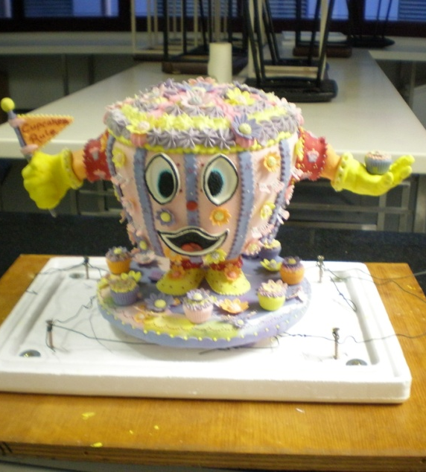
Plan sugar display piece
Plan display piece
2 dimensional or 3 dimensional
Height
Width
Be realistic
Base drawing on A4 size paper
Notes:
Trainer to advise:
When designing a piece to begin keep it basic; be realistic
Use A4 size paper as your base for all drawings
All stencils must be able to fit inside the parameters of this size, if not smaller

Slide 30
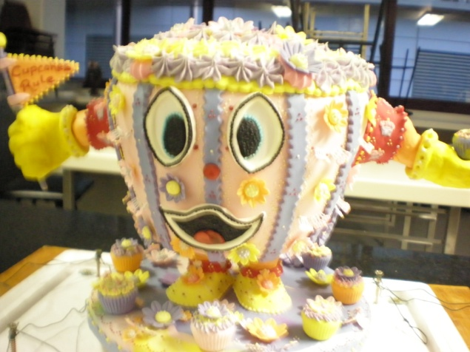
Plan sugar display piece
Plan display piece
2 dimensional or 3 dimensional
Two dimensional: height and width
Theme
Colour
Notes:
Trainer to advise:
Plan before you start
In beginning it is best to copy another work.
See how others have planned and developed their them
To begin just do one colour then two develop technique

Slide 31

Plan sugar display piece
Plan display piece
Three dimensional:
Height
Width
Depth
Base to stand it on
Back to be higher than the front
Cascade forward
Notes:
Trainer to advise:
When planning your piece look for it to fall forward toward the front
Do not have something sitting at the back that cannot be seen, unless you have it on a rotating base

Slide 32

Plan sugar display piece
Prepare sketch or outline of display
Rough outline
Theme
Simplicity
Notes:
Trainer to advise:
Keep drawing simple
Look to set up curves so they run evenly
Remember to have base flat so it can sit
Keep it simple in beginning
Squares
Ovals
Circles
Geometric shapes of different sizes

Slide 33
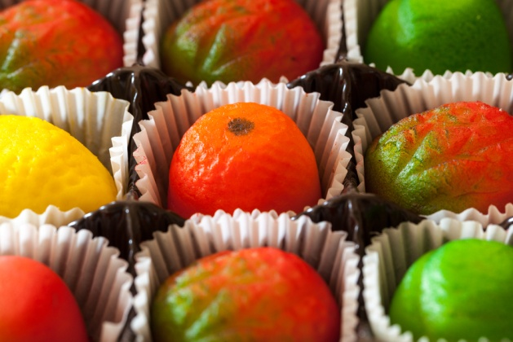
Plan sugar display piece
Prepare forms or shapes to match design
Use stencil to cut design in plasticine
Use round metal ring to shape foil for mould
Hand mould to shape
Oil inside so sugar does not stick
Notes:
Trainer to advise:
Stencil: a cardboard shape of design laid over the plasticine to cut into plasticine for desired shape
This is a one time mould; stencil can be used many times
Keep plasticine wrapped to prevent drying
Some practitioners lay thin foil inside plasticine to prevent sticking, some apply oil to edge
Shape some foil using a metal cake ring; this comes in handy when more than one piece is required
Smaller pastry cutters can also be used for moulding
As long as they are secured and will withstand the heat of the molten solution

Slide 34
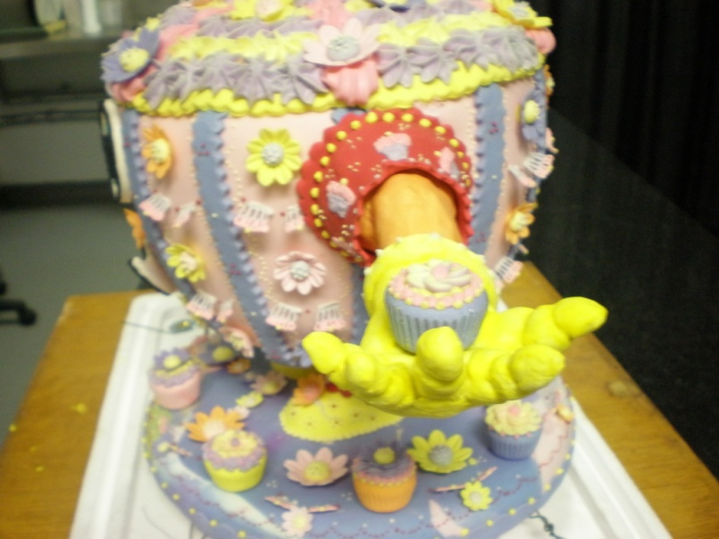
Plan sugar display piece
Calculate quantities required for display
Practice cast or piece sizes
Notes:
Trainer to advise:
Depends on the size that is being made
Up to 50% more than the actual finished piece

Slide 35

Prepare and display sugar work
Element 7: Assemble and display sugar work
Assemble sugar work
Decorate sugar work piece
Display sugar work piece
Notes:
Trainer to advise:
Trainer to relate performance criteria to element 7
Performance criteria is the process by which the students training match the learning element
The element is the skill
To assess competency in the skill; the performance criteria is used to outline activities that can be used to assess competency.
The trainer should relate how the performance criteria is related to the element
To be able to Prepare and display sugar work the students must be able to; Assembly and display sugar work
The student should be able to do
Plan display piece appropriate to client, occasion or theme able to be produced in time available using a variety of techniques
Prepare a sketch or outline of display
Prepare forms and shapes as required by the design
Calculate quantities required for components of display piece

Slide 36

Assemble and display sugar work
Assemble sugar work
Start from the base
Front to back or back to front
Try to keep seals hidden from front view
Notes:
Trainer to advise:
Starting with a clean workspace have all pieces lined up in assembly line
Check all equipment is available
Heat edges of pieces to be joined with spirit lamp or blow torch
REMEMBER: you only need to heat to join, do not melt and deform the shape
Have a fan to assist with cooling
In warmer climates cooling of sugar will be slower

Slide 37

Assemble and display sugar work
Decorate sugar work piece
Adding to base design
Edging
Painting with fine brushes
Other sugar pieces
Notes:
Trainer to advise:
Decoration of the sugar can be done after it has been assembled
Balls can be painted with food colours to produce faces
Smaller pieces of sugar can be melted and touched to other colours to show eyes, noses attached
Liquid colours can be sprayed to add lustre to the sugar surface

Slide 38
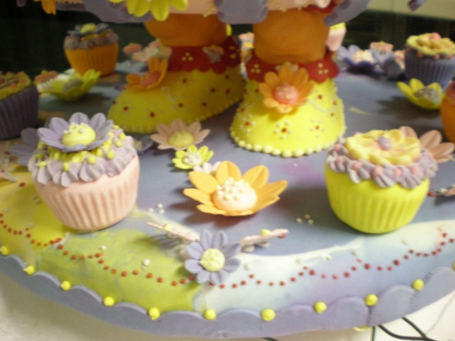
Assemble and display sugar work
Display sugar work piece
Positioning
Lighting
Static or rotating
Notes:
Trainer to advise:
There are many ways to show a sugar display
Behind protection shield
Static surface
Rotating base; requires electric motor
How will lighting be used to highlight piece

Slide 39

Prepare and display sugar work
Element 8: Store sugar display pieces
Store according to enterprise and standard industry practice
Store in appropriate conditions
Store to maintain maximum quality and appearance
Notes:
Trainer to advise:
Trainer to relate performance criteria to element 8
Performance criteria is the process by which the students training match the learning element
The element is the skill
To assess competency in the skill; the performance criteria is used to outline activities that can be used to assess competency.
The trainer should relate how the performance criteria is related to the element
To be able to Prepare and display sugar work the students must be able to; Store sugar display pieces
The student should be able to
Store according to enterprise and standard industry practice
Store in appropriate conditions
Store to maintain maximum quality and appearance

Slide 40
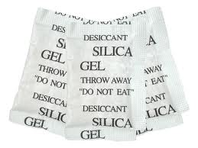
Store sugar display work
Store according to enterprise requirements
Store in appropriate conditions
Store to maintain maximum quality and appearance
Store in closed dry environment
Sealed containers
Store with silica gel sachets
Notes:
Trainer to advise:
Sugar works will not have a long life due to its hydroscopic properties
Isomalt is better for storage of finished sugar work

